Slide 1
LiDAR odometry
or SLAM alg.
fig.地图初始化集合
初始化
Scans
fig.强度标定
fig.分割
fig.几何识别
fig.初始化结果
Poses
物体跟踪
fig.静态地图结果
紧耦合
fig.地图先验
fig.物体级别跟踪结果
fig.待跟踪帧集合

Slide 2
LiDAR odometry
or SLAM alg.
Scans
Poses
Prior map
(Ground truth)

Slide 3
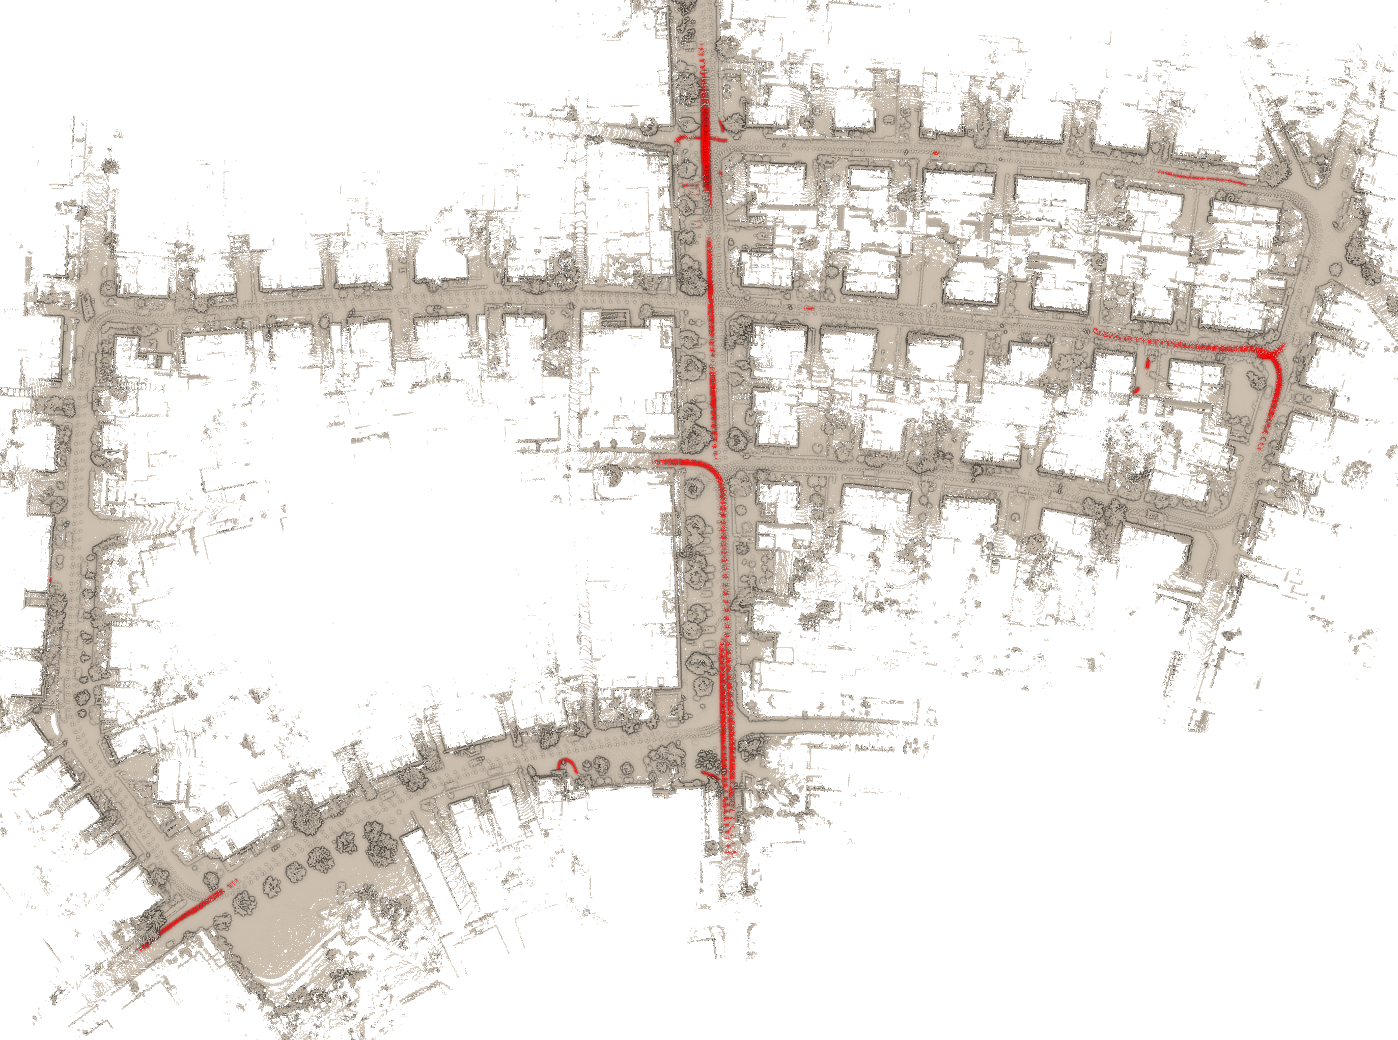
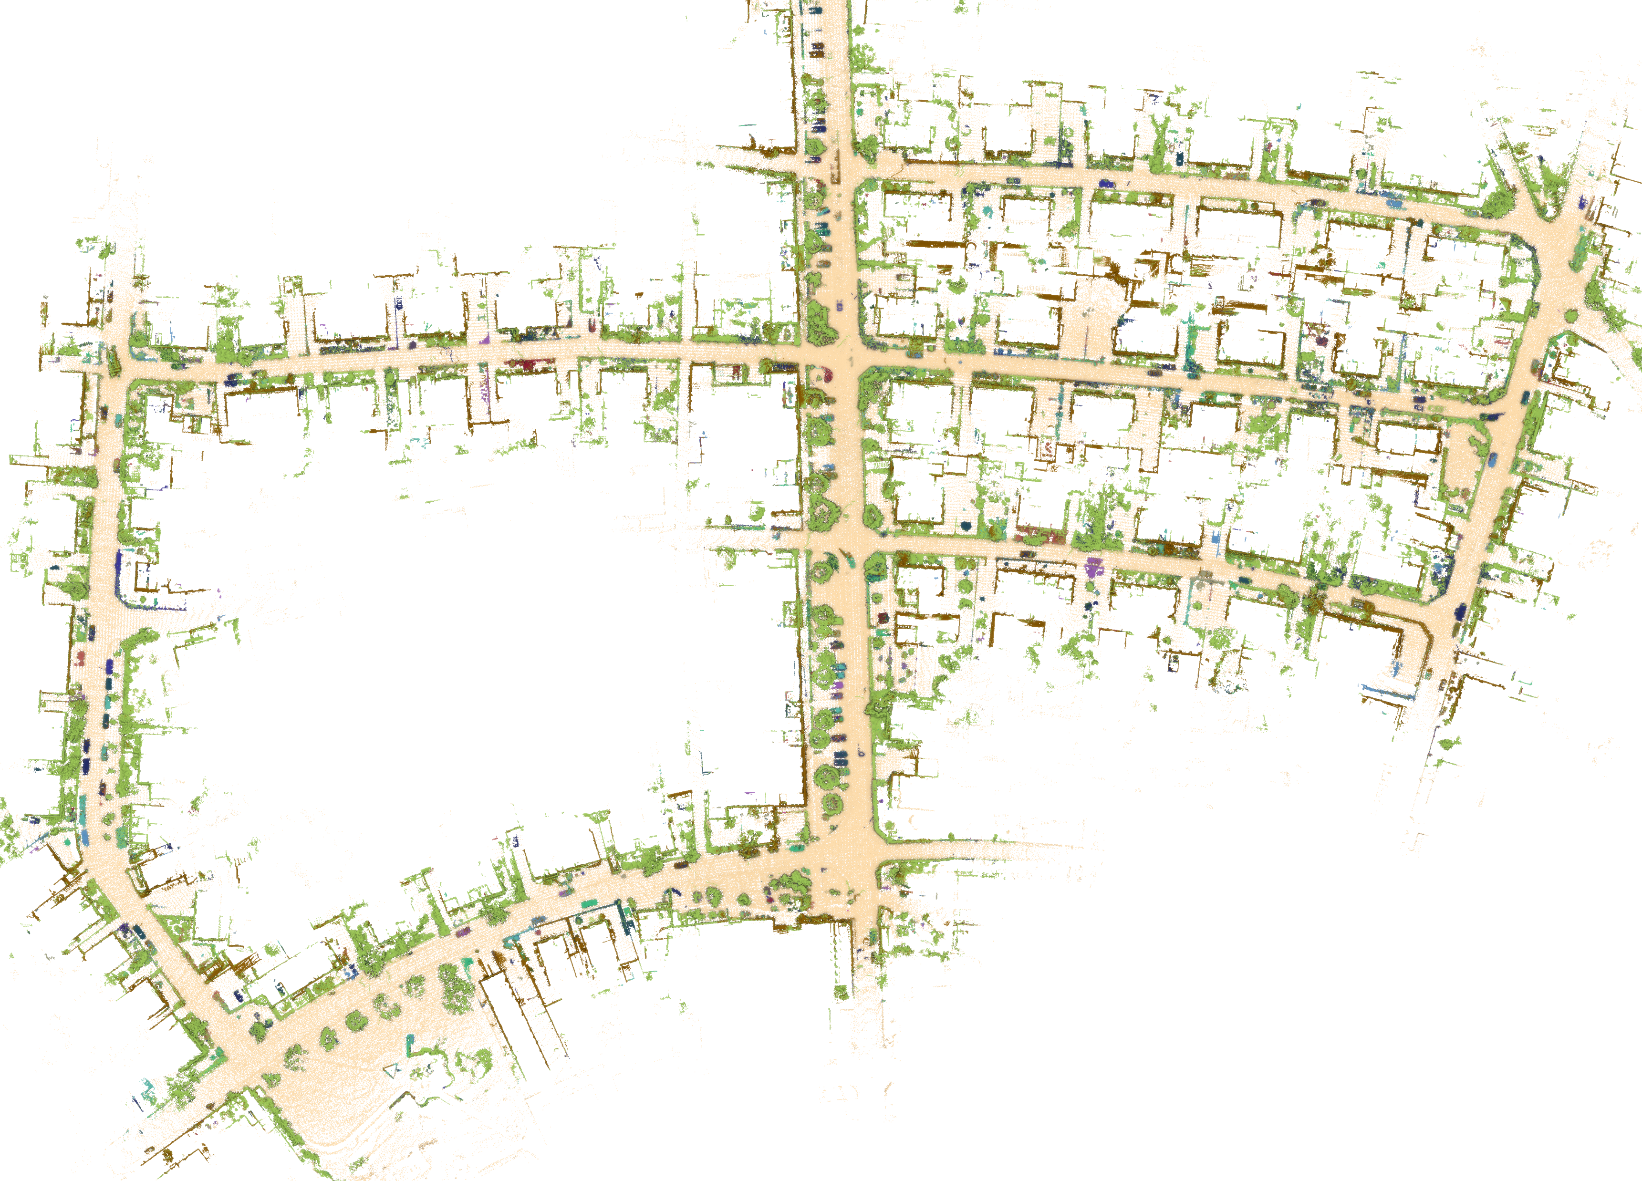
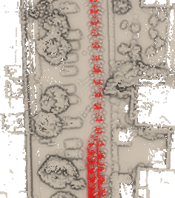
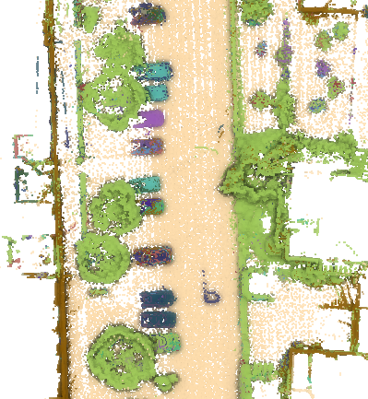
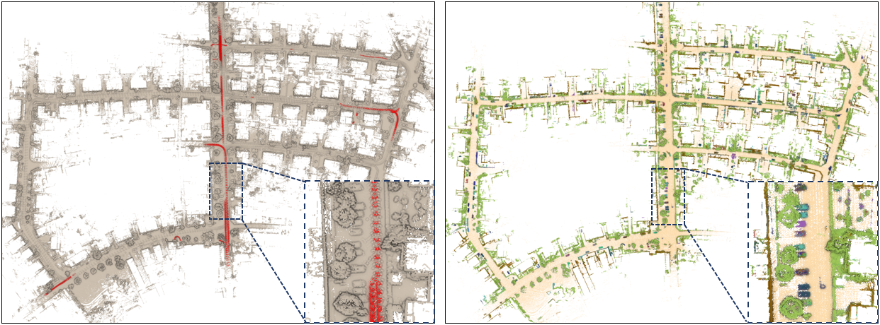

Slide 4
Step1:
Convert coordinate into spherical
Step2:
Build CVI map using curved-voxel
Step3:
Find neighbor CVI to check intensity
Step4:
Combine neighbor points to be clusters
Step5:
Refine clusters by Iterative growth
某一帧俯视图

Slide 5
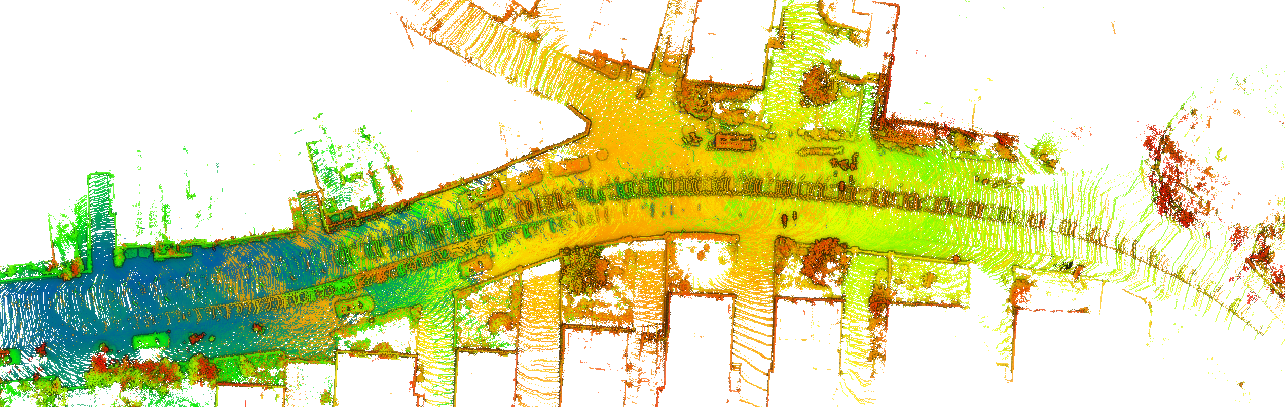
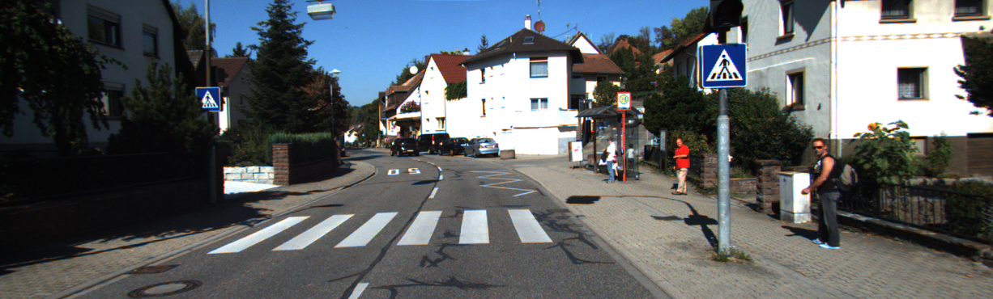
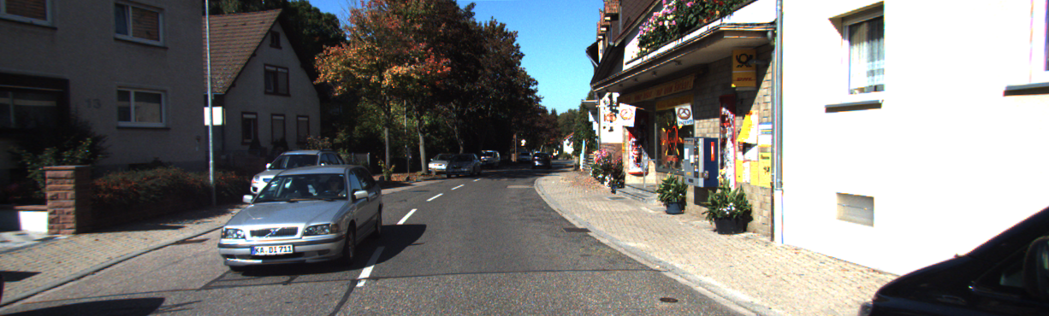
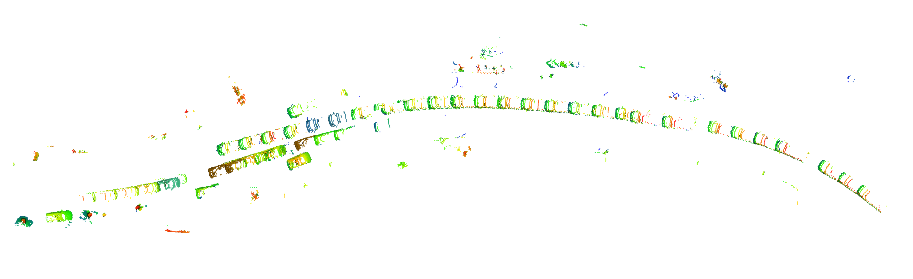
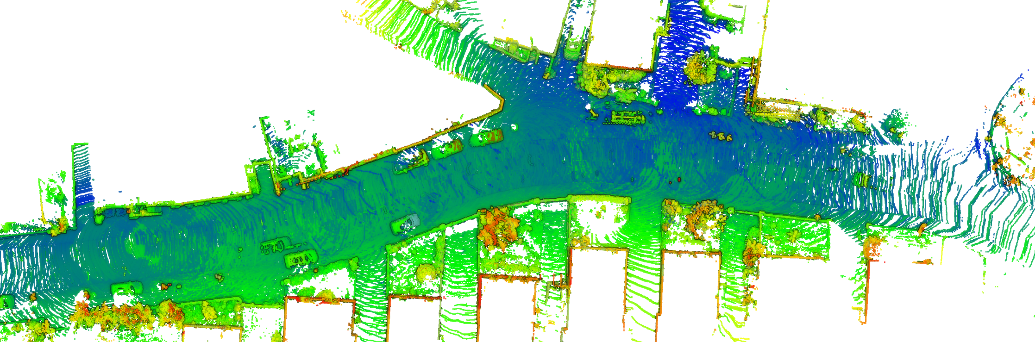
Original map
Frame 1138
Frame 1186
Dynamic map
Static map

Slide 6
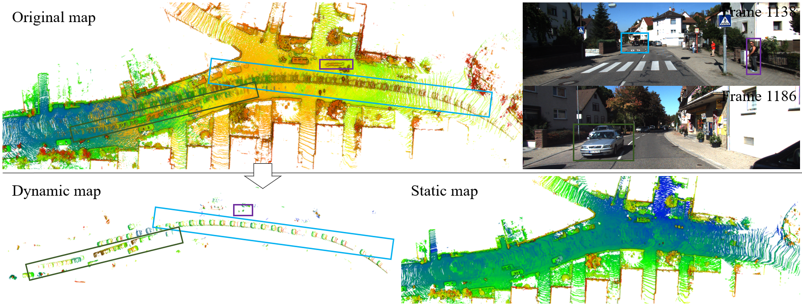

Slide 7
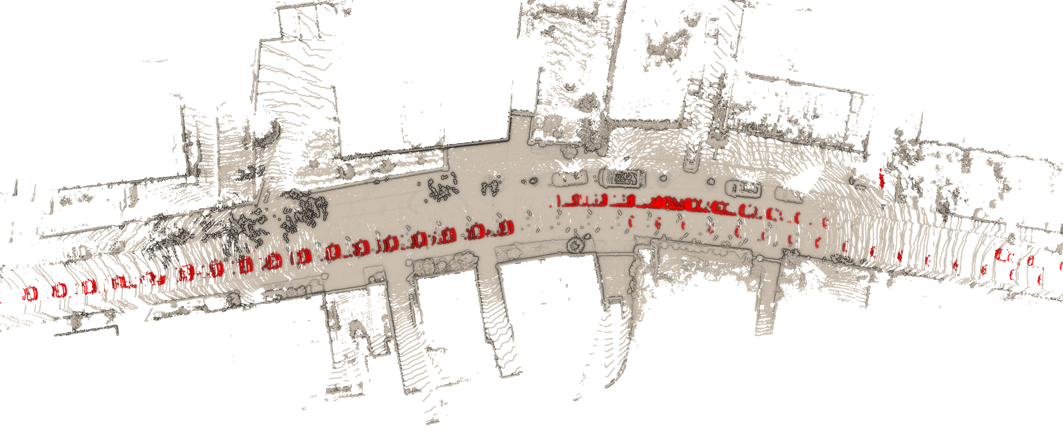
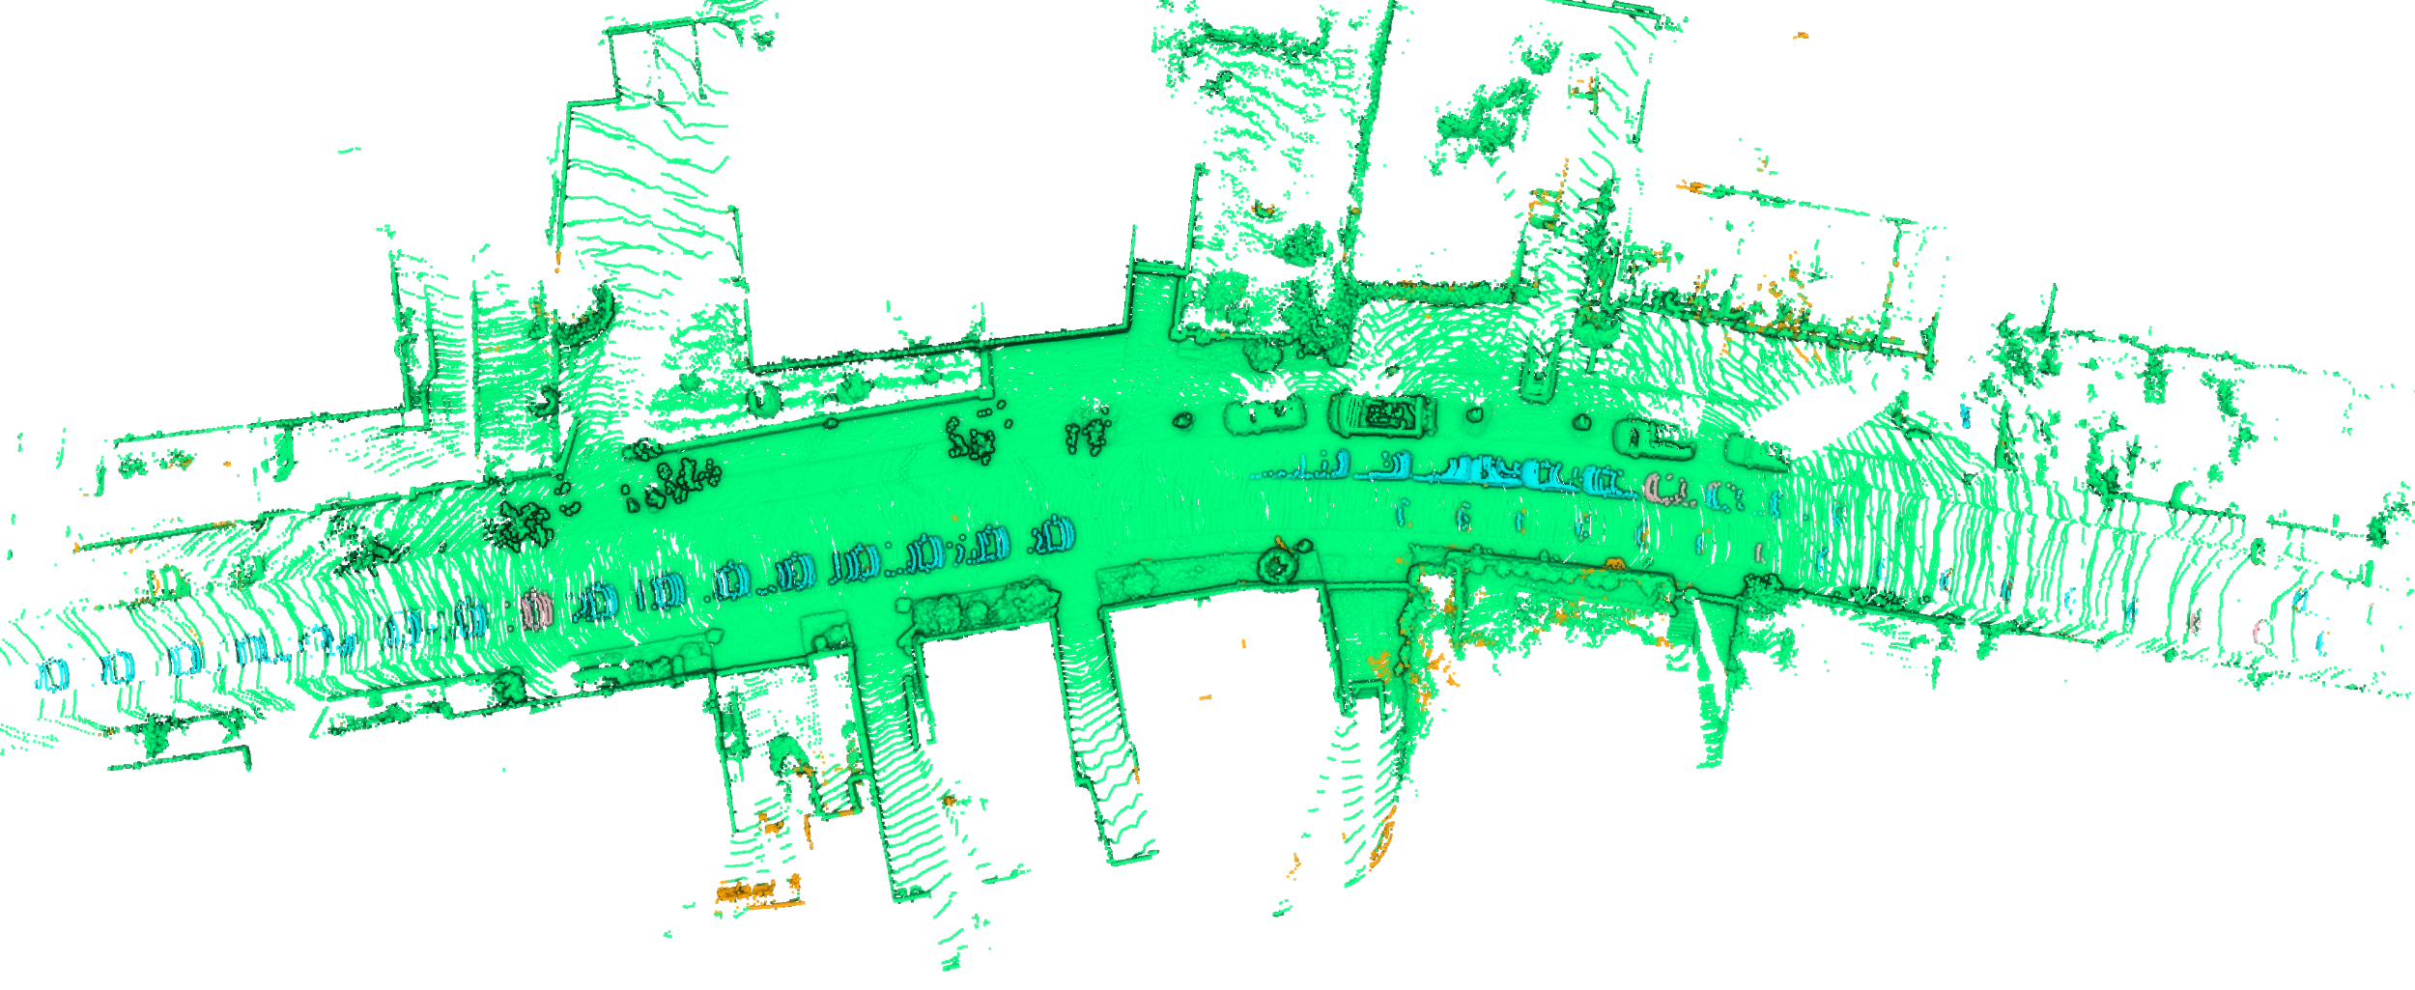
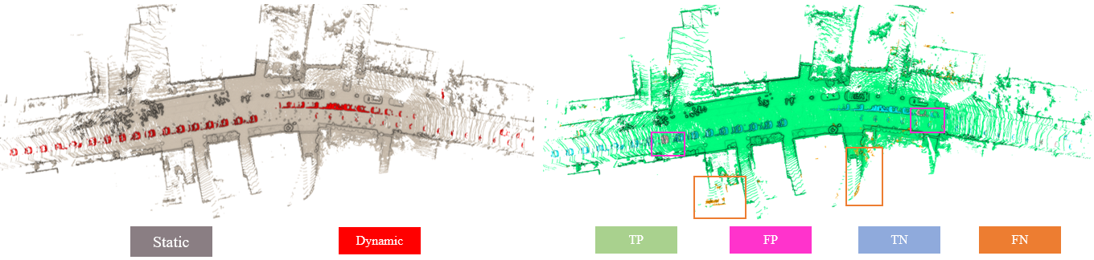
Static
Dynamic
TP
FP
TN
FN

